Slide 1

IoT-Based Personal Safety & Tracking System
Embedded IoT Systems (Fall 2025)

Slide 2



Our Team: Driving Innovation
Haider Ali
Ahmad Bin Zia
Abdullah
Project Lead
System Logic
Physical Prototype

Slide 3


Multipurpose SoS & Live Tracking System
1
2
Portable Device
Real-time Logging
A compact, cellular-connected safety device.
Continuous cloud logging for location data.
3
Emergency Monitoring
Features emergency voice monitoring capabilities.

Slide 4

Project Objectives: Hybrid Communication
We aim to build a standalone, portable IoT device for personal safety (children, elderly, or assets).
SMS/GSM
For immediate offline emergencies.
GPRS/Internet
For continuous data logging.

Slide 5

Key Functionality:
SOS Panic Mode
Trigger Mechanism
Activated by holding down a dedicated push-button.
Immediate Actions
Initiates a voice call to a pre-set emergency contact.
Sends an SMS with static Google Maps coordinates.

Slide 6

Key Functionality: Live Tracking & Monitoring
Continuous Live Tracking
Silent Monitoring (Spy Mode)
On-Demand Location
Guardians can request current location via SMS or web dashboard refresh.
Pushes location data packets to a remote database at set intervals (e.g., every 30 seconds) for history playback.
Device auto-answers calls from guardians, allowing them to listen to surroundings via an onboard microphone.

Slide 7






Hardware Components: The Building Blocks
ESP32 Dev Module
NEO-6M GPS Module
SIM800L GSM Module
Power Source (Battery)
Veroboard
Push Buttons & Materials

Slide 8


Software Stack: Powering the System
Platformio-vscode
Integrated development environment for efficient coding.
Communication Protocol:
Raw HTTP over GSM 2G using ThinkSpeak’s ThingHTTP as a bridge.
Cellular Network
Ensuring connectivity for data transmission and calls.
NEXTJS + Database
ExpressJS server hosted on VERCEL connected to a database to store
Location history.

Slide 9



System Architecture: Portable IoT Unit
Push Button
ESP32
NEO-6M
Panic Trigger
Microcontroller
GPS Module
SIM800L
Microphone
Cellular Module
Audio Input

Slide 10

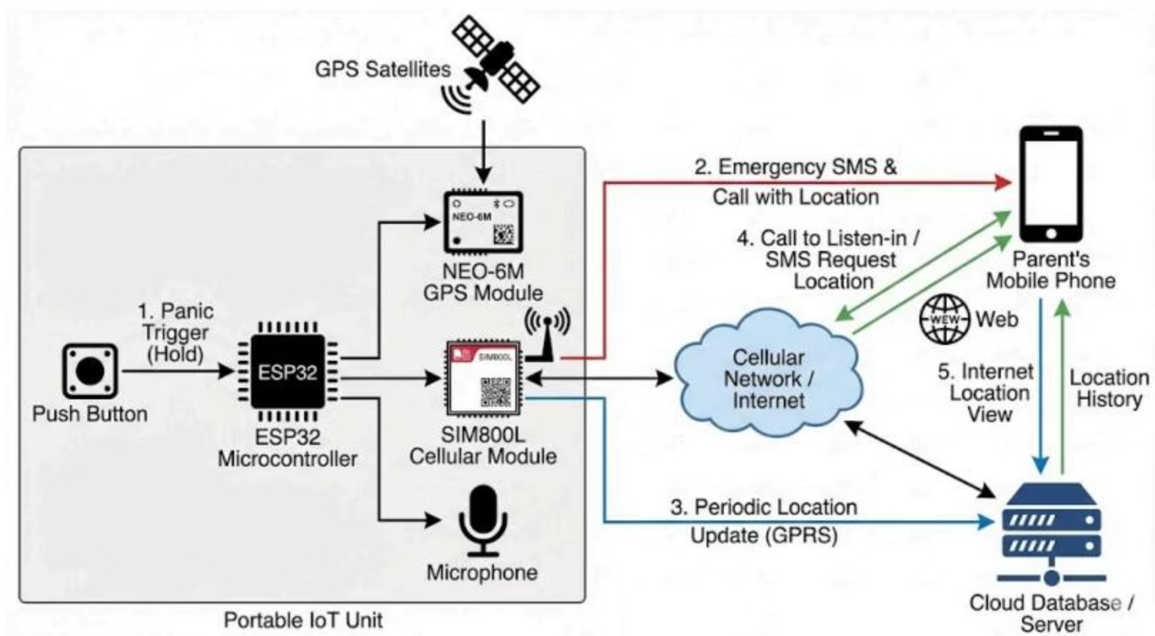




System Architecture: Communication Flow
Panic Trigger
Activates ESP32
Emergency Alert
SMS & Call to Parent
Location Update
Periodic GPRS to Server
Parent Interaction
Call/SMS Request
Location History
View on Cloud

